Slide 1

“Face Recognition Attendance System”
TERNA ENGINEERING COLLEGE
DEPARTMENT OF COMPUTER ENGINEERING
Under the guidance of
Guide Name
Mr .Vishwajit Gaikwad
Academic Year
2022-23
Class SE/Sem 4/ Div B /Roll No B40,B29
Group members name : Yash Phuke
: Kiran Mishra

Slide 2
Abstract:
The face detection & Attendance marking system is a computer vision project that utilizes OpenCV, Firebase, and facial recognition algorithms. The objective of this project is to create an automated attendance system that can capture an image or video stream, detect faces using face_recognition (dlib), match the detected faces with the faces stored in Firebase's real-time database, and finally, mark attendance for recognized faces.
This project has various potential applications in the education and corporate sector, where attendance management is a critical task. The automated attendance marking system can help reduce the time and effort required for manual attendance marking, improve accuracy, and provide real-time insights into attendance patterns.

Slide 3
Introduction:
The traditional method of taking attendance in schools, colleges, and organizations involves calling out the names and marking attendance manually, which is not only time-consuming but also prone to errors. With the advancement in technology, automated attendance systems have become increasingly popular, and one such system is the face detection attendance system.
The face Recognition Attendance system is a modern-day solution that leverages computer vision and artificial intelligence (AI) algorithms to automatically capture attendance data by recognizing the faces of individuals. The system is designed to streamline the attendance-taking process, minimize human intervention, and eliminate errors.
Overall, this report aims to provide insights into the development of a face detection attendance system and its potential to revolutionize the attendance-taking process.

Slide 4
Literature survey:
Face Detection System | Key Features | Applications
Amazon Rekognition | Facial analysis, facial recognition, and face search | Security and surveillance, customer engagement, and user verification
Microsoft Azure Face | Face detection, verification, identification, and grouping | Security and surveillance, access control, and digital marketing
IBM Watson Visual Recognition | Image and facial analysis, face detection and recognition, and age and gender estimation | Security and surveillance, retail and e-commerce, and healthcare
Google Cloud Vision | Face detection, recognition, and tracking | Security and surveillance, access control, and digital marketing
FaceFirst | Face detection and recognition, face matching, and real-time alerts | Law enforcement, retail and e-commerce, and event security

Slide 5
Need Of Work
Work in face recognition systems is essential for a variety of applications, including security, access control, and personal identification. By accurately identifying and verifying individuals based on their facial features, these systems can help prevent fraud, enhance public safety, and improve the overall efficiency of various processes.
It has become crucial for organizations to implement robust security measures to protect sensitive information and assets. Face recognition systems provide a non-intrusive and convenient way of verifying a person's identity, making them an attractive option for applications such as access control, surveillance, and law enforcement. However, to achieve high levels of accuracy and reliability

Slide 6
Problem Statement :
Traditional attendance taking methods involve manual recording of attendance, which is time-consuming and prone to errors. Furthermore, it can be difficult to identify students or employees who are absent or tardy, which can lead to issues with accountability and productivity. To overcome these challenges, there is a need for an automated attendance system that can accurately and efficiently record attendance.

Slide 7
Objectives:
To design a face detection attendance system that can accurately and efficiently capture attendance data.
To develop an algorithm that can recognize faces in various lighting conditions and orientations.
To integrate the face detection algorithm with a database to enable real-time attendance recording and monitoring.
To evaluate the performance of the system by comparing its accuracy and efficiency to traditional attendance taking methods.
To assess the potential impact of the face detection attendance system on organizations, students, and teachers in terms of time-saving, improved accuracy, and enhanced productivity.

Slide 8
Scope
As Present the Face recognition tool is at its early stage , as we develop it to a larger extend and make it commercial , we’ll probably keep costs of purchase lower than overrated market is currently providing , considering their prices to reach the sky later.
Other Face recognition services ,only serve as Security Tool , in this we are going to merge the video conferencing , chat box features so that it can also act as a substitute to Zoom , Google meet along with Face recognition service.

Slide 9
Proposed system:
It has the following components:
Camera: This system uses a high-resolution camera that captures images of individuals' faces in real-time.
Face detection algorithm: The system utilizes a face detection algorithm that can recognize faces in various lighting conditions and orientations. OpenCV is a popular face detection algorithm that was used.
Firebase System: It stores attendance data in its database system.
User interface: The system has a user interface that allows users to view attendance data, monitor attendance in real-time, and generate reports.
Real-time attendance monitoring: The system provides real-time attendance monitoring, allowing teachers or administrators to track attendance in real-time and take immediate action if necessary.

Slide 10
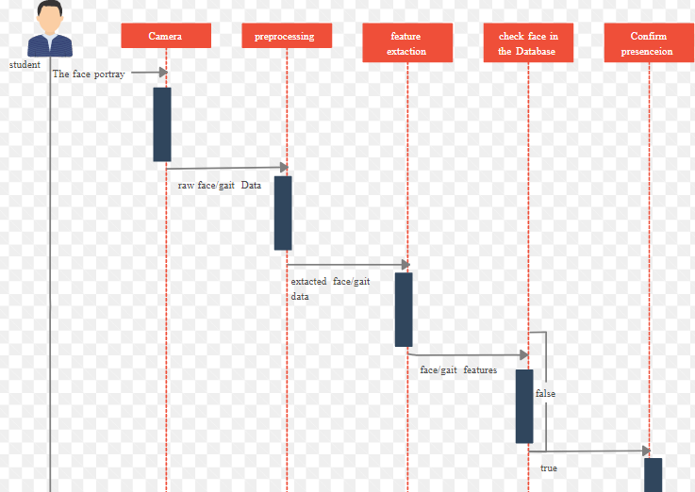
Gantt Chart

Slide 11
Student Contribution
As a Team , each individual has equally participated in all parts of project areas. Hence ,we could roughly categorise as:
Yash : Project Researching about OpenCV, Code Implementation majorly Backend , Coding Testing ,Camera Set up ,Firebase Set up and Execution .
Kiran : Project Researching about OpenCV, Code Implementation majorly GUI, Coding Testing ,Firebase Set up and Execution .

Slide 12
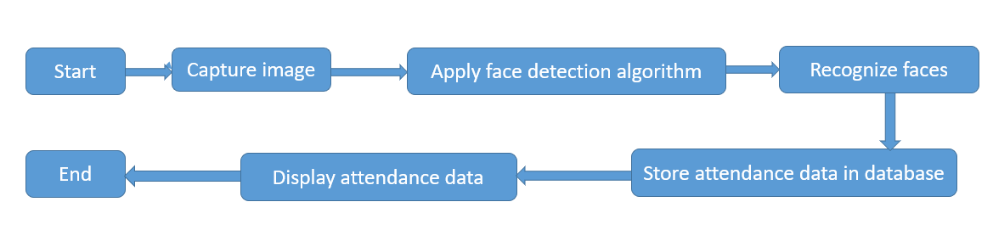
Architecture:
This Attendance system has a client-server architecture, consisting of two main components: the client-side and the server-side. The client-side includes the camera, which captures images of individuals' faces, and the user interface, which displays attendance data and allows users to monitor attendance in real-time. The server-side includes the face detection algorithm, which analyzes images and recognizes faces, and the database management system, which stores attendance data.
Flowchart:
Start
Capture image
Apply face detection algorithm
Recognize faces
End
Display attendance data
Store attendance data in database

Slide 13
Block Diagram:
The following block diagram illustrates the components of the proposed face detection attendance system and their interactions:
Camera
Registration
Upload Data In Firebase
Updating Records In Firebase
Taking Attendance
Checking Whether Encod Is Generated

Slide 14
Methodology:
The project involves three main steps :face detection, face Recognition, and Attendance marking.
The proposed system works as follows:
First, we use OpenCV's Haar cascades to detect faces in the input stream .The captured images of individuals' faces are forwarded for face detection.
Once a face is detected, we use facial recognition algorithms to match the detected face with the faces stored in the Firebase real-time database .
If a match is found, we mark the attendance for that individual, and the attendance record is updated in Firebase.
The attendance data is then accessible in real-time, which can be used to generate reports and insights on attendance patterns. The system can also be integrated with other applications to automate further tasks, such as sending notifications to absentees or generating alerts for latecomers.
Overall, the proposed system offers an efficient and accurate solution for attendance-taking, which can save time and improve productivity in various domains. The system can be customized to meet the specific requirements of different organizations, making it a versatile solution for attendance management.

Slide 15
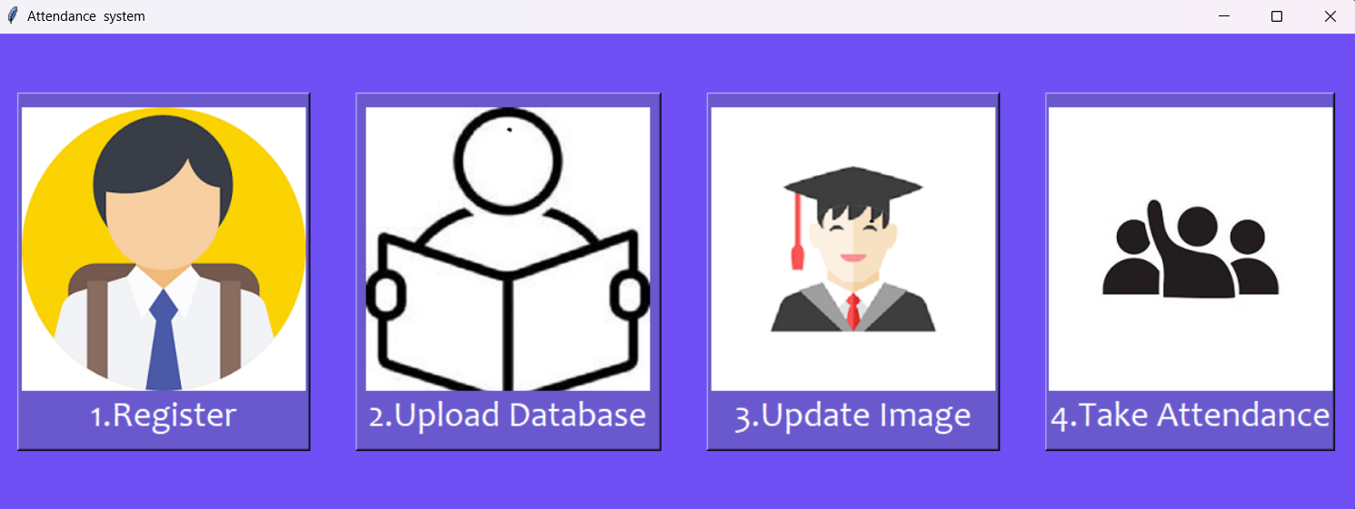
Result & Discussion:
Here , the main section containing all the process units :

Slide 16
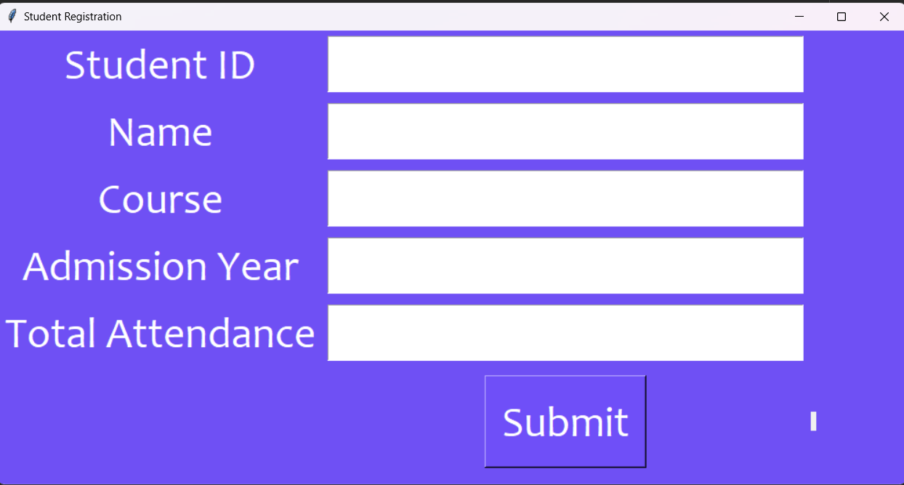
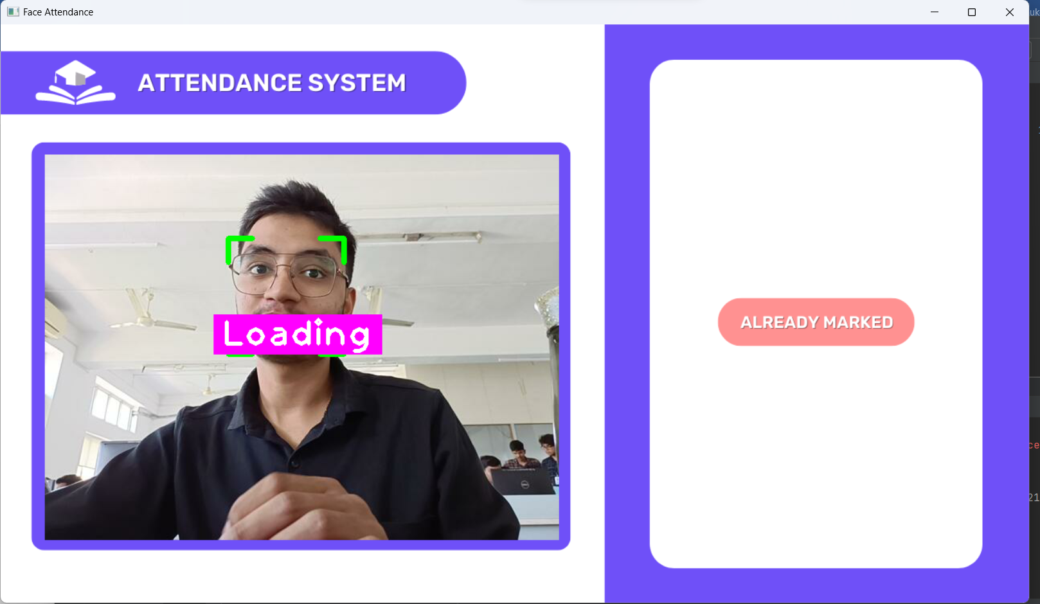
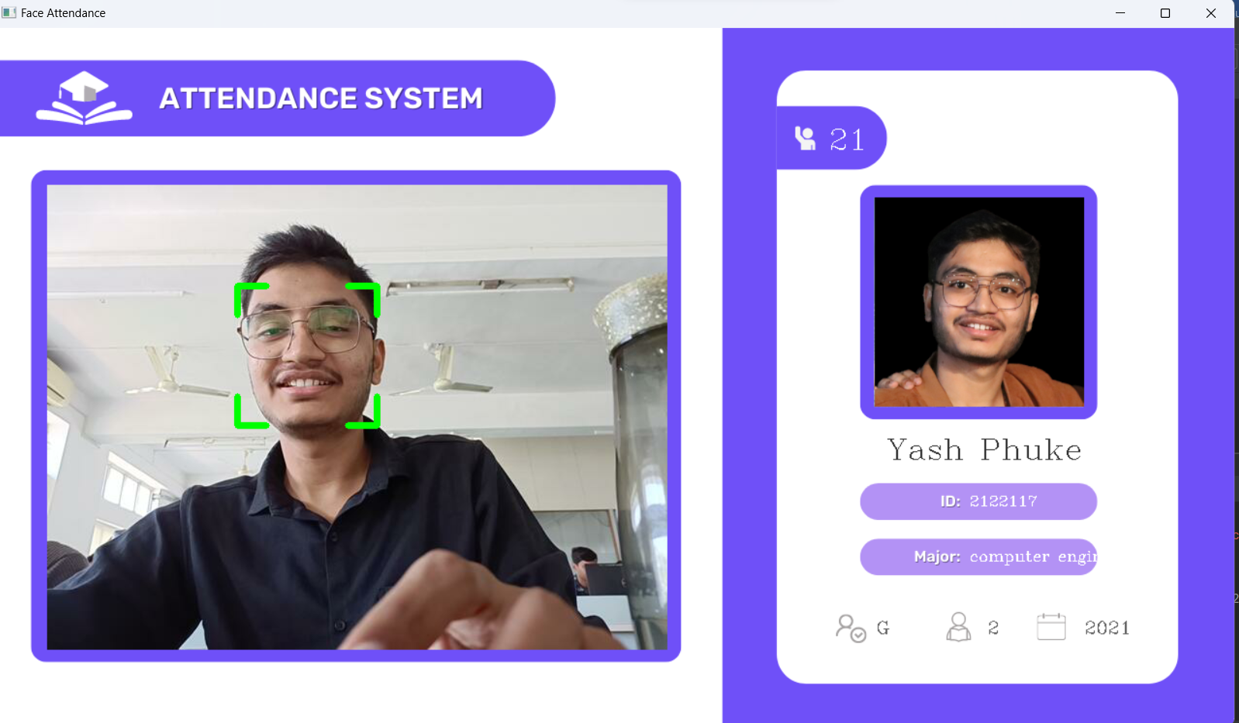

Slide 17
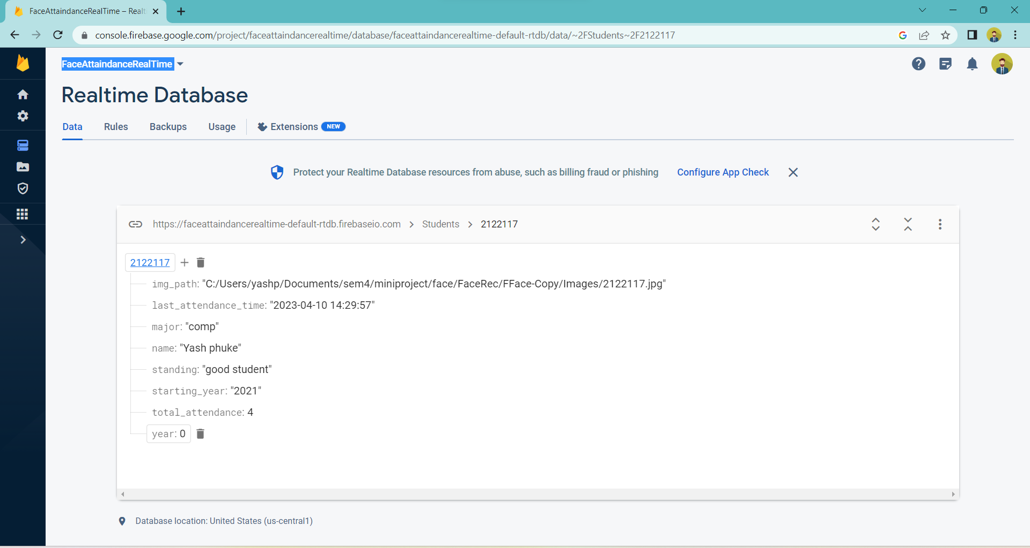

Slide 18
Conclusion:
This system is an efficient and accurate solution for attendance-taking that leverages computer vision and AI algorithms. The system automates the attendance-taking process by recognizing individuals' faces and storing attendance data in a database system. The user interface allows users to monitor attendance in real-time and generate reports, making it an ideal solution for various domains, including education, healthcare, and corporate settings.
The system's implementation requires a camera capable of capturing high-quality images, a face detection algorithm capable of recognizing faces in various lighting conditions, and a database management system capable of storing attendance data. The system can be customized to meet the specific requirements of different organizations, making it a versatile solution for attendance management.

Slide 19
Future Scope:
The face Recognition attendance system can be further enhanced in several ways to improve its accuracy, efficiency, and usability. Some of the future scope areas include:
Integration with other biometric authentication methods such as fingerprint, iris, or voice recognition to increase security.
Integration with machine learning algorithms to improve face detection accuracy and reduce false positives and false negatives.
Adding Featues Of Online Video Conferencing & Chatbox.
Development of a mobile application that can access attendance data and provide real-time notifications to students, teachers, or administrators.
Integration with blockchain technology to increase data security and transparency.

Slide 20
References:
https://ieeexplore.ieee.org/document/8974493
https://www.researchgate.net/publication/323390774_Face_detection_and_Recognition_A_review/
OpenCV: Face Detection. Retrieved from https://docs.opencv.org/master/d7/d8b/tutorial_py_face_detection.html
https://medium.com/@ageitgey/machine-learning-is-fun-part-4-modern-face-recognition-with-deep-learning-c3cffc121d78
https://www.youtube.com/watch?v=6qQZr9h8qL0/
Ingle, R., & Bhardwaj, R. K. (2017). Development of attendance management system using face recognition. International Journal of Advanced Research in Computer Engineering & Technology, 6(11), 249-251.

